Slide 1




KIET GROUP OF INSTITUTIONS
“ Shaping Your Mind ”
MAJOR PROJECT
Project Supervisor: Asst. Prof. S.D.Mishra

Slide 2


Slide 3
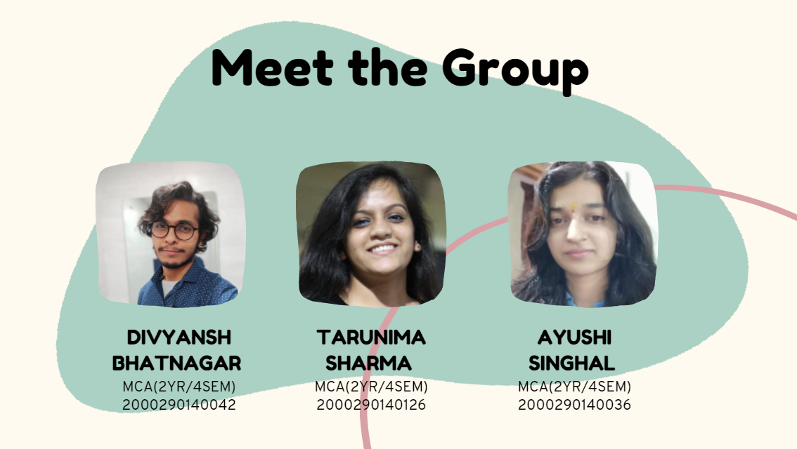

Slide 4
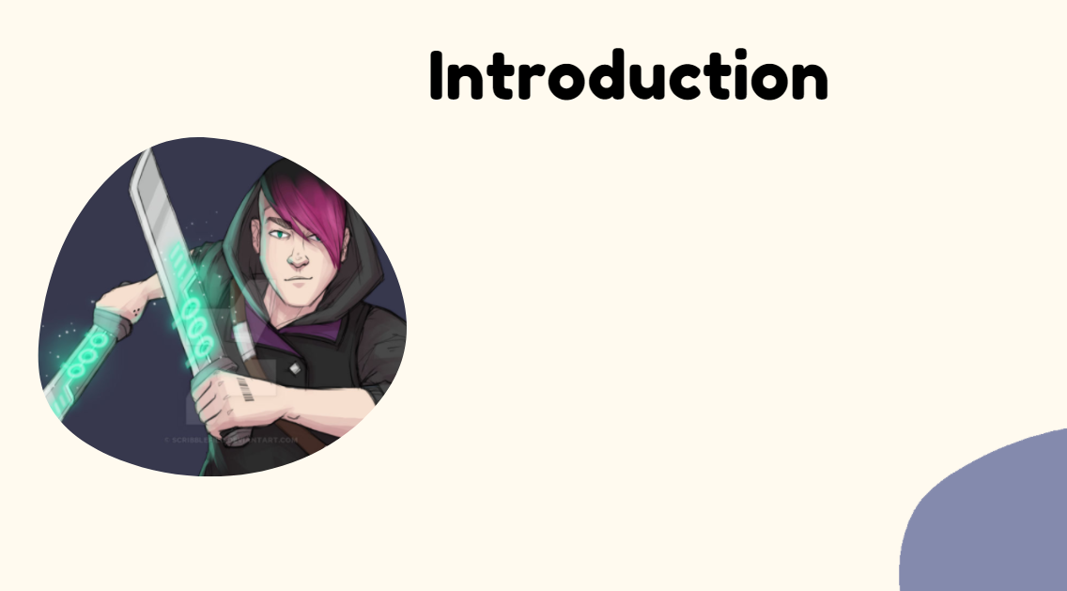
This project is aimed at developing a website for gaming. The Game Hub provides an easy interface that would let the users to the pool of gaming. It provides the users more pleasure and gladdening his mind by playing these traditional games such as Tic Tac Toe, Fruit Ninja, Flappy Bird. It also provides users to interact with other players who are login to the website, even while gaming. Players can compete with other players based on the scores they achieve.

Slide 5
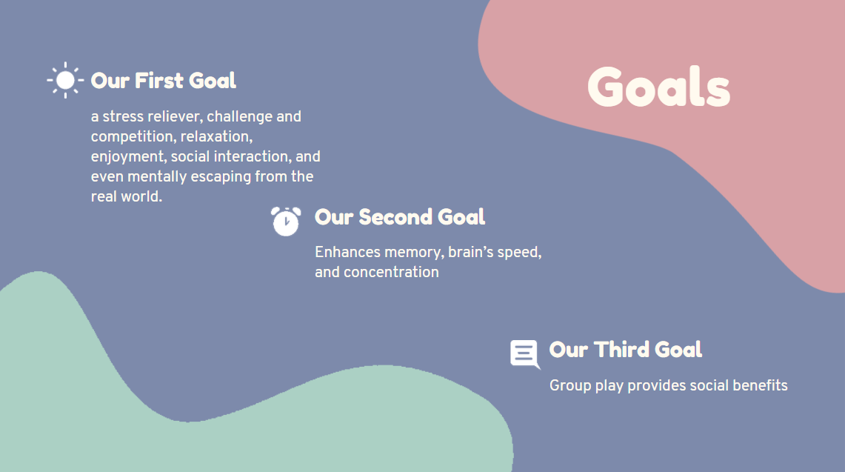

Slide 6
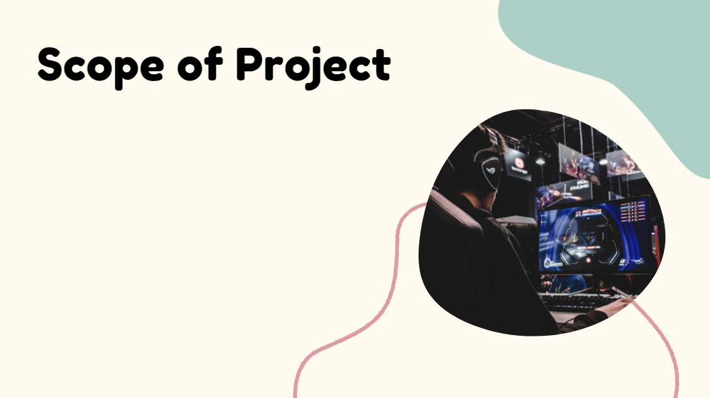
Platform that provides quick and easy access to your favorite game apps and consoles. Gaming gives relaxation and enjoyment to every user.
In this busy world,
gaming is the solution to release the depression and tension. Social networking with gaming is
a nice combo for any user who was addicted to the world of gaming. The requirements speciﬁed in this document will be used for designing all the aspects and components

Slide 7
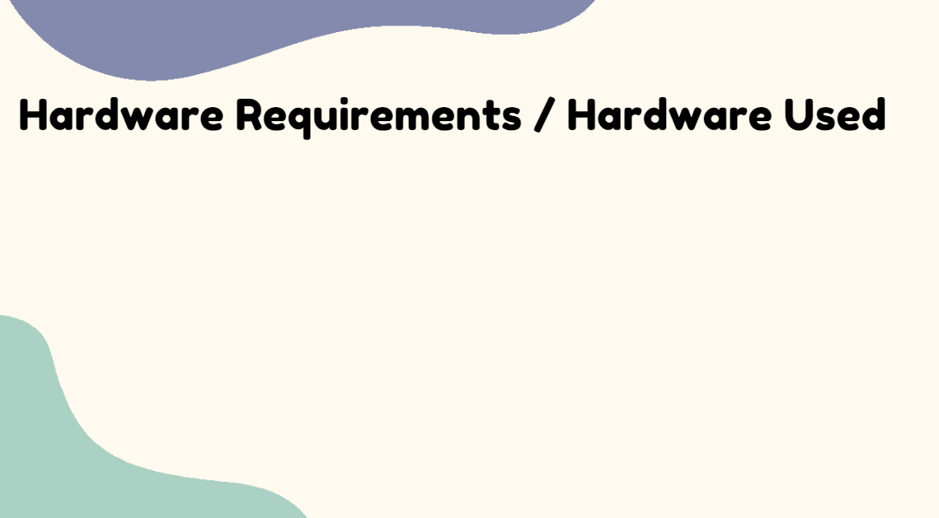
Central Processing Unit (CPU) –
Intel Core i5 6th gen or AMD processor equivalent
RAM –
2 GB minimum, 8 GB or higher is recommended.
Graphics Processing Unit (GPU) –
NVIDIA GeForce GTX 960 or higher
Operating System (OS) –
Ubuntu or Microsoft Windows

Slide 8

IDE: VS code.
Programming Language: Python

Slide 9
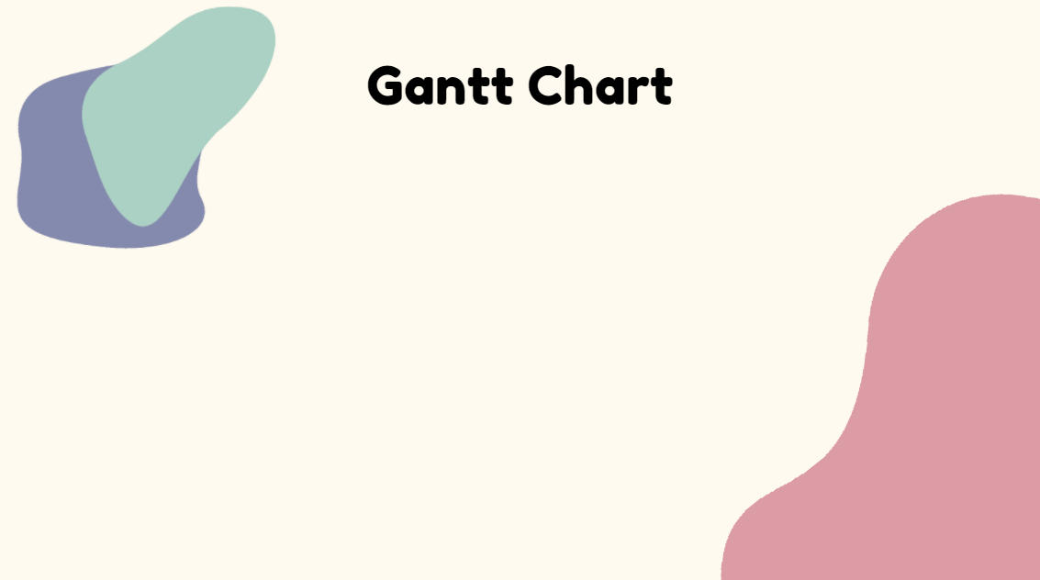
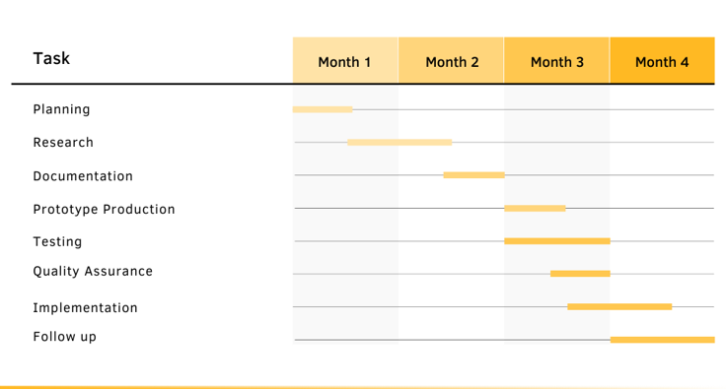

Slide 10


